Slide 1

Unit 1: Starter
The global language
U ovoj ćeš lekciji saznati zašto engleski jezik nazivamo globalnim jezikom.

Slide 2
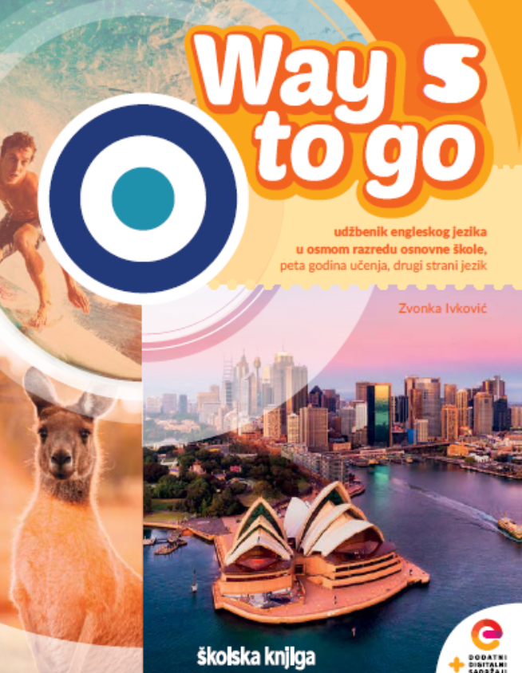
Treasure Hunt
1 How many units are there in the student's textbook?
2 How many people can you see on the page 15?
3 Which three countries are culture spots about?
4 Which famous writer can you see on the page 38?
5 Which famous queen is mentioned on the page 42?
6 What is the full title of the Unit 3?
7 Which famous athlete is Project 3 about?
8 What is Marmite, as described on the page 67?
9 What are the names of two masterpieces on the page 74?
10 How many different items can you buy on the webshop on the page 86?
5
4
Australia, New Zealand and Canada
Oscar Wilde
Queen Victoria
Challenge yourself
Simone Biles
A sticky, dark, brown spread
Café Terrace at night and Head of Franz Kafka
10

Slide 3
Open your book, page 10
Task 1: Where did you see or hear English today? Tick what is true for you.

Slide 4
Task 2: Complete the text with the words from the box.
billion
modern
international
entertainment
empire
influencers
colonies

Slide 5
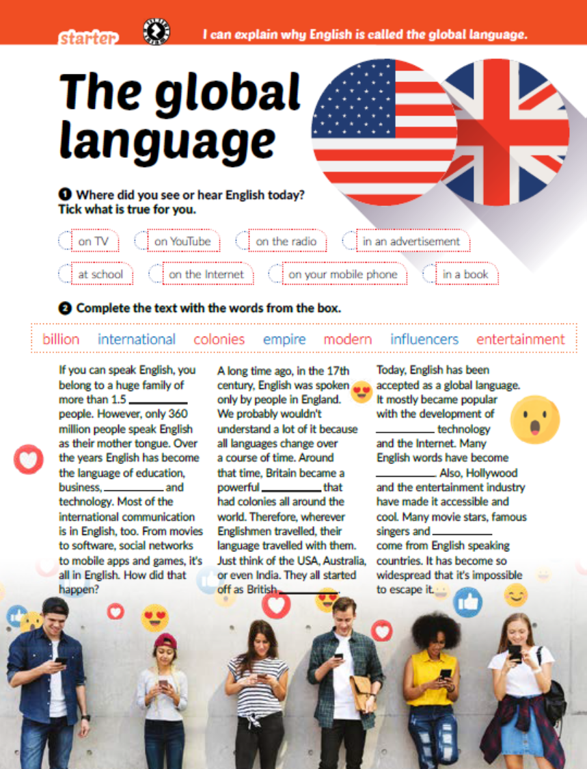
Task 3: Read the text again. Are the sentences true or false? Write T (true) or F (false).
F
F
T
T
F
F

Slide 6

Task 4: Read the text again and complete the sentences.
1 I find it interesting that…
2 I find it surprising that…
3 I have already known that…
4 I didn’t know that…

Slide 7
Task 5: Answer the questions.
1 How many English speaking countries can you name?
2 How many people in the world speak English as their second language?
3 How many English speaking movie stars and influencers can you name?

Slide 8
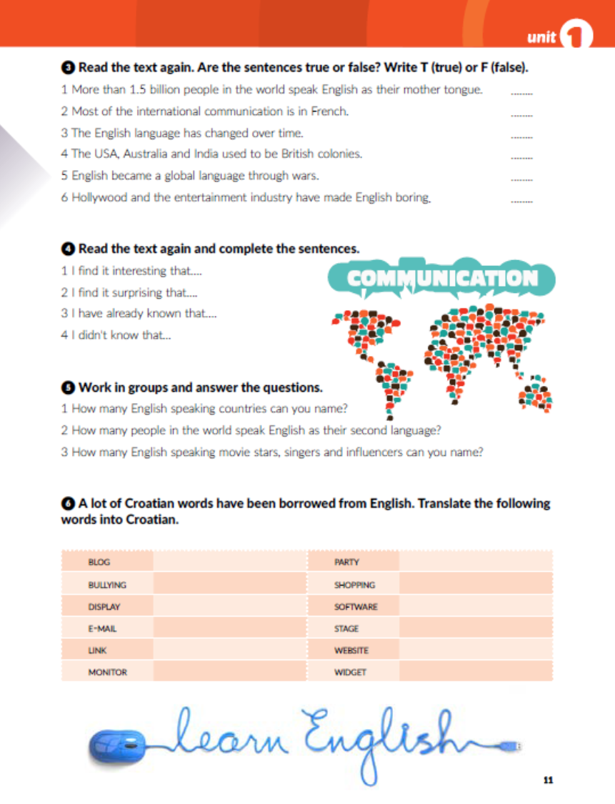
Task 5: Translate the following words into Croatian.
blog
zabava
vršnjačko nasilje
kupovina
zaslon
programska podrška
e-pošta
pozornica
poveznica
mrežna stranica
monitor
programčić

Slide 9
Open your workbook, page 5
Do the tasks and check your answers.
2
4
7
5
6
8
3
1 000 000
1 000
1 000 000 000

Slide 10

Otvori sljedeće poveznice, te odaberi PLAY AND LEARN!
https://wordwall.net/play/12159/339/714
https://wordwall.net/play/12160/352/969

